Slide 1
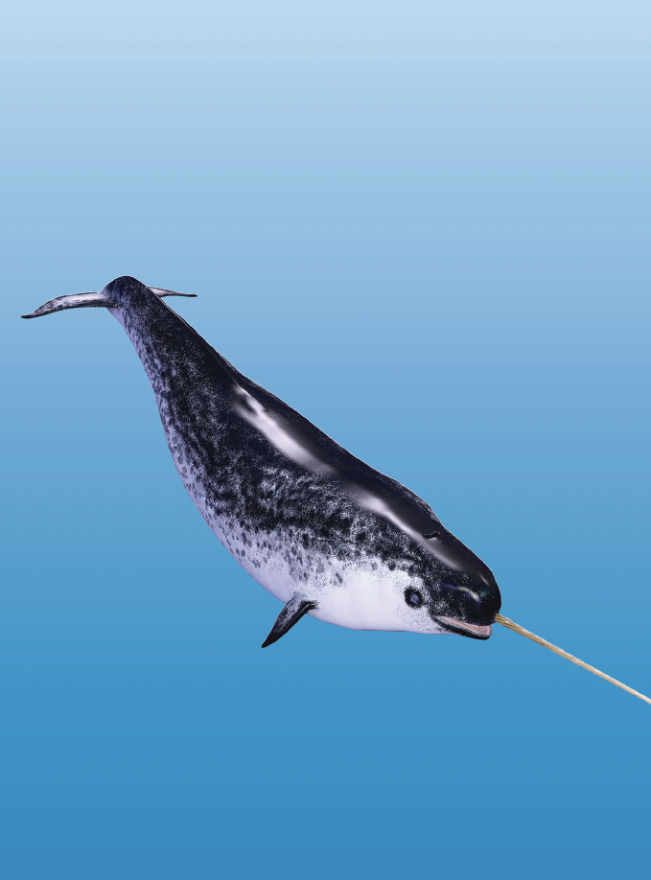
Teaching Resources and Instructors’ Guidelines
Chapter 7: Search strategies for innovation

Slide 2
Chapter 7: Search strategies for innovation
In the following PowerPoint slides you will find the key headings from CHAPTER 7 together with the main illustrations, tables, etc.
There are also slides summarizing the key messages in bullet-point fashion, and a wide range of activities which you can use to help students explore around these themes.
Finally there are some reflection questions which can be used as the basis for discussion or assignments.

Slide 3
Learning Objectives
By the end of this chapter you will develop an understanding of:
the different kinds of opportunity being sought in terms of incremental or radical change
the different search needs at different stages of the innovation process
the different players involved in the search process, and in particular the growing engagement of more people inside and outside the organization
local search aiming to exploit existing knowledge through to radical and beyond into new frames
mechanisms for enabling search

Slide 4


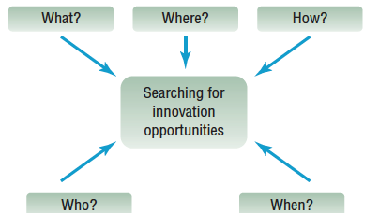
Mind map

Slide 5

Core themes and material from the book

Slide 6
A framework for thinking about search

Slide 7


Push or pull?
- The reality is that innovation is never a simple matter of push or
pull but rather their interaction; as Chris Freeman, one of the pioneers of innovation research said, ‘necessity may be the mother of invention but procreation needs a partner!’.
- There is a risk in focusing on either of the ‘pure’ forms of push or pull sources. If we put all our eggs in one basket we risk being excellent at invention but without turning our ideas into successful innovations –a fate shared by too many would-be entrepreneurs.

Slide 8
Incremental or radical innovation?
Innovation can happen along a spectrum running from incremental (‘do what we do, but better’) through to radical (‘do something completely different’).
- We’ve also seen that there is a pattern of what could be termed ‘punctuated equilibrium’ with innovation – most of the time innovation is about exploiting and elaborating, creating variations on a theme within an established technical, market or regulatory trajectory.
- Occasionally there is a breakthrough which creates a new trajectory –and the cycle repeats itself.
- This suggests that much of our attention in searching for innovation triggers will be around incremental improvement innovation.

Slide 9
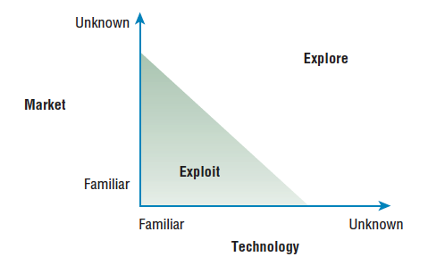
Exploit or explore?

Slide 10
Exploit/explore?
- On the one hand firms need to deploy knowledge resources and other assets to secure returns and a ‘safe’ way of doing so is to harvest a steady flow of benefits derived from ‘doing what we do better’. This has been termed ‘exploitation’ by innovation researchers, and it essentially involves ‘the use and development of things already known’.
- The trouble is that in an uncertain environment the potential to secure and defend a competitive position depends on ‘doing something different’, i.e. radical product or process innovation rather than imitations and variants of what others are also offering. This kind of search had been term ‘exploration’ and is the kind which involves ‘long jumps or re-orientations that enable a firm to adopt new attributes and attain new knowledge outside its domain’.

Slide 11
When?
Another influence on our choice of search approach is around timing – at different stages in the product or industry life cycle the emphasis may be more or less on push or pull.
Mature industries will require a very different approach to new industries.
- Another important influence on the timing question is around diffusion – the adoption and elaboration of innovation over time.
Understanding diffusion processes and the influential factors is important because it helps us understand where and when different kinds of triggers are picked up.
- Lead users and early adopters are likely to be important sources of ideas and variations which can help shape an innovation in its early life, whereas the early and late majority will be more a source of incremental improvement ideas.

Slide 12
Who?
Knowledge networks
Knowledge connectors
Knowledge flow
Knowledge concentration
Knowledge architecture
Knowledge transformation, articulation and assimilation

Slide 13

Where to search?
- A key problem in searching for innovation opportunities is not just that such firms fail to get the balance between exploit and explore right but also because there are choices to be made about the overall direction of search.
Search space is not one-dimensional.
Innovation rarely involves dealing with a single technology or market but rather a bundle of knowledge which is brought together into a configuration.
- Successful innovation management requires that we can get hold of and use knowledge about components but also about how those can be put together – what they termed the architecture of an innovation.

Slide 14
Where? The innovation treasure hunt
Firms can be radical innovators but still be ‘upstaged’ by developments outside their search trajectory. The problem is that search behaviour is essentially bounded exploration and raises a number of challenges:
- When there is a shift to a new mind-set – cognitive frame - established players may have problems because of the reorganization of their thinking which is required.
This is not simply a change of personal or even group mind-set –the consequence of following a particular mind-set is that artefacts and routines come into place which block further change and reinforce the status quo.
- Architectural - as opposed to component innovation – requires letting go of existing networks and building new ones.
- The new frame may not necessarily involve radical change in technology or markets but rather a rearrangement of the existing elements.

Slide 15
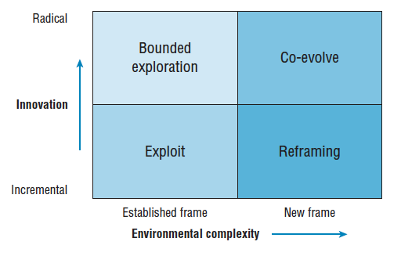
A map of innovation search space

Slide 16
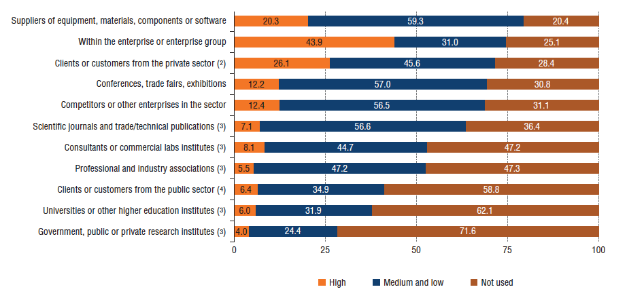
Sources of innovation

Slide 17
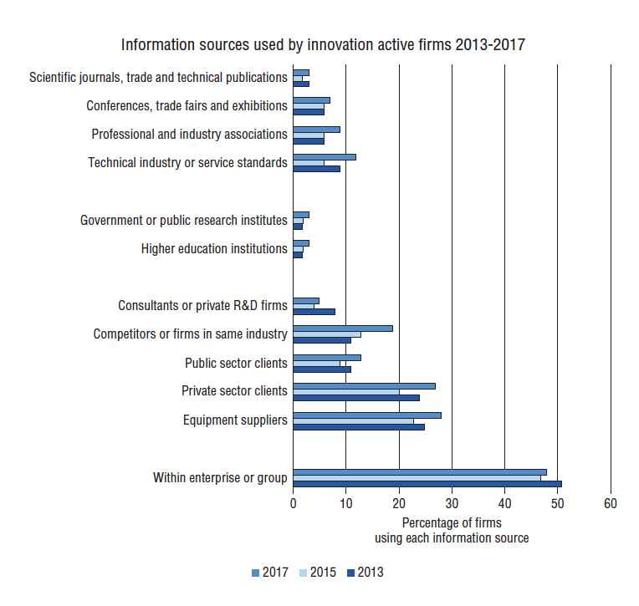
Information sources for innovation

Slide 18
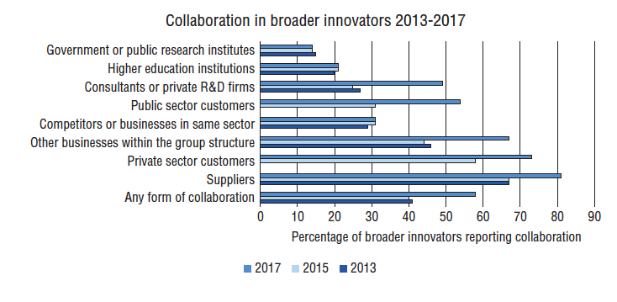
Increasing collaboration in innovation

Slide 19
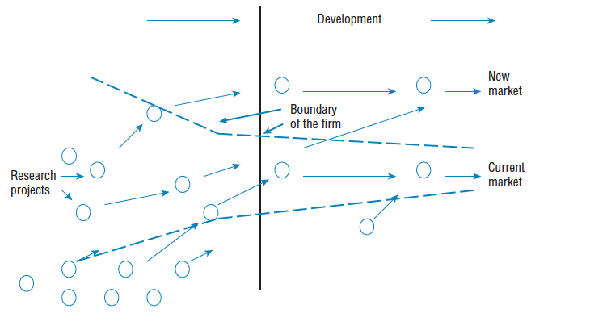
The open innovation model

Slide 20
Absorptive capacity
- One more broad strategic point concerns the question of where,
when and how organizations make use of external knowledge to grow.
The reality is, of course, that they differ widely in their ability to make use of such trigger signals – and the measure of this ability to find and use new knowledge has been termed ‘absorptive capacity’(AC).
It is an important construct because it shifts our attention to how well firms are equipped to search out, select and implement knowledge.
AC is essentially about accumulated learning and embedding of capabilities –search, acquire, assimilate, etc. –in the form of routines (structures, processes, policies and procedures) which allow organizations to repeat the trick.
Firms differ in their levels of AC and this places emphasis on how they develop and establish and reinforce these routines.

Slide 21
Managing internal connections
One area which has seen growing activity addresses a fundamental knowledge management issue which is well expressed in the statement – if only xxx (insert the name of any large organization) knew what it knows!’ In other words how can organizations tap into the rich knowledge (and potential innovation triggers) within its existing structures and amongst its workforce?
Much of the knowledge lies in the experience and ideas of ‘ordinary’ employees. Increasingly organizations are trying to tap into such knowledge as a source of innovation via various forms of what can be termed ‘high involvement innovation’ systems such as suggestion schemes, problem solving groups and innovation ‘jams’.
- There has also been an explosion in the use of internal online platforms to encourage and enable idea submission, development and acceleration.

Slide 22

Enabling external connections
Search strategies include:
- Sending out scouts
- Exploring multiple futures
- Innovation markets
- Working with active users
- ‘Deep diving’
- Probe and learn
- Corporate venturing
- Use brokers and bridges

Slide 23
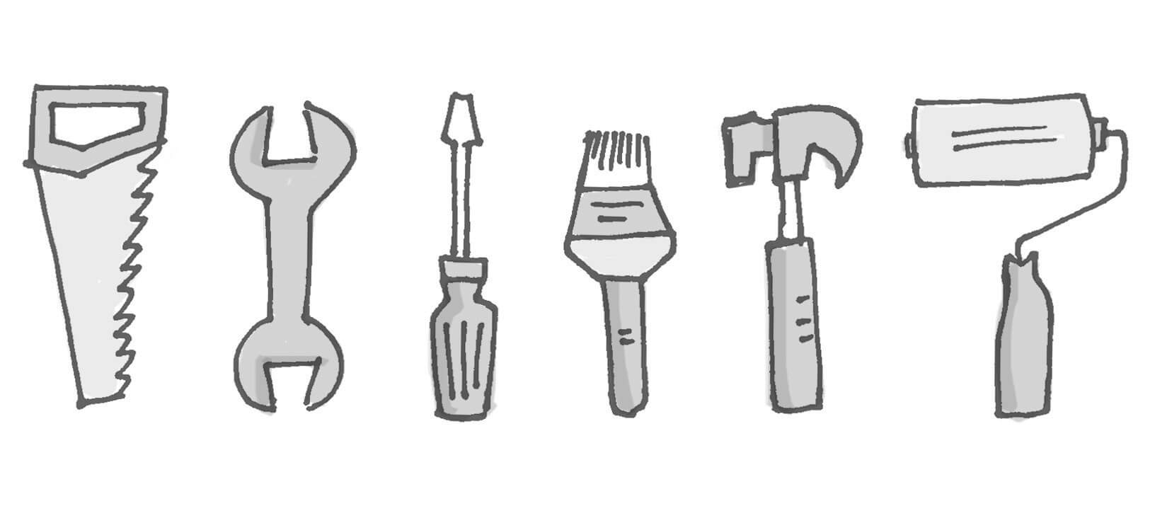
Enabling search for innovation
Within this broad framework firms deploy a range of approaches to organizing and managing the search process.
- R&D units can be structured to enable a balance between applied research (supporting the ‘exploit’ type of search) and more wide-ranging, ‘blue sky’ activities (which facilitate the ‘explore’ side of the equation).
Choice of techniques and structures depends on a variety of strategic factors like those explored above – balancing their costs and risks against the quality and quantity of knowledge they bring in.

Slide 24
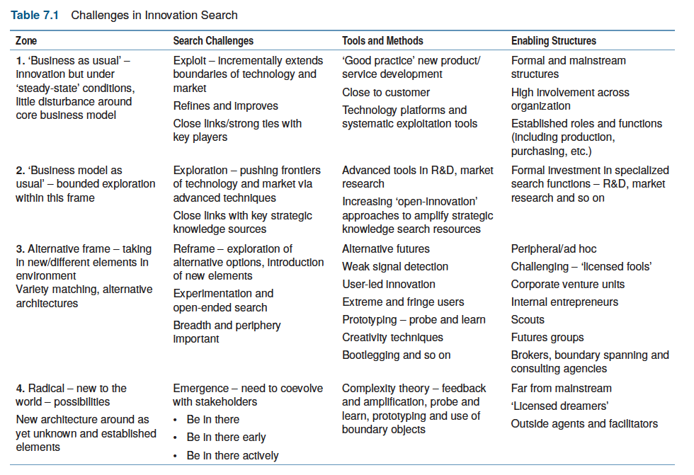
Challenges in innovation search

Slide 25
Summary
In this chapter we have been concerned not so much with the many sources of innovation as with how to mobilise effective search strategies to explore these systematically.
- We have also developed an understanding of the different kinds of opportunity being sought in terms of incremental or radical change.
- The different search needs at different stages of the innovation process
the different players involved in the search process, and in particular the growing engagement of more people inside and outside the organization.
- Local search aiming to exploit existing knowledge through to radical and beyond into new frames.
- Mechanisms for enabling search.

Slide 26

Videos
There are several videos which can help explore and present the key themes of the chapter:
Search strategies
Tools for innovation search
Notes:
Short videos

Slide 27
Videos
Interview with Michael Bartl of Hyve, talking about the use of ‘netnography’ in the search for new innovation opportunities
Interview with Emma Taylor talking about mobilizing employees as a source of innovation
Series of films about a start-up, Tidewave, and its journey to scale
Interview with Pedro Oliveira talking about the Patient Innovation platform, a way of mobilizing user innovators in the healthcare space
Interviews with doctors from the Torbay Hospital in the UK talking about their approaches to finding process innovation opportunities
Interview (audio) with Helen King of the Irish Food Board talking about their use of futures methods to search for innovation opportunities
Interview with Lynne Maher, UK National Health Service talking about user experience as a source of innovation
Eric von Hippel talking about user innovation methods

Slide 28

Managing internal knowledge connections
Follow the link below to watch a video of Francisco Pinheiro, Strategic Innovation Manager with Atos, discussing the challenges of getting innovative ideas from employees via internal online platforms in the company

Slide 29
Videos
Follow the link to watch a video of an interview with Hugh Chapman, Managing Director of Veeder Root discussing employee involvement in innovation and how it can contribute to sustained successful performance

Slide 30
Media: Managing internal knowledge connections
Follow the link below to watch a video interview with John Neill, chief executive of Unipart, about the logistics group’s methods for improving productivity, including a ‘university’ and ‘faculties on the floor’ for continuous training and monitoring.
https://www.ft.com/video/a0fc02bc-fdef-30aa-8b64-6cd10a77065f

Slide 31
Managing internal knowledge connections
Follow the link below to hear a podcast on how seller feedback has allowed companies like ebay to grow in the way they have
https://www.bbc.co.uk/programmes/p059zb6n

Slide 32
Media: Extending external connections
Follow the link below to hear an interview with Perry Chen, principal founder of the crowdfunding platform, Kickstarter.
https://www.stitcher.com/podcast/national-public-radio/how-i-built-this/e/50961272

Slide 33
Media: Extending external connections
Follow the link below to hear a podcast on how market research marked a shift from a producer-led to a consumer-led approach to business
https://www.bbc.co.uk/programmes/w3csv3gm

Slide 34
Activities
There are a variety of activities (for both groups and individuals and for online as well as offline work. These include:

Slide 35
Activity: Managing internal connections
Take 10 minutes to list as many innovations as you can that were the product of exploiting internal knowledge connections
What means were used to capture this knowledge?
What were the benefits of these forms of knowledge capture? And what, if any, were the downsides?
Try to think of a time when you were involved in a process of internal knowledge capture, for example, within a firm you worked in. How did the process make you feel? Were you able to take ownership over the innovation? & what was the final output?

Slide 36
Activity Extending external connections
Take 10 minutes to list as many innovations as you can that were the product of crowd-sourcing in its various iterations
- What were the benefits gained through this process?
- Were there any downsides?

Slide 37
Activities – Search Strategies
Activities include:
- The 4P’s
- Uses for…
- TRIZ
- The way we do things around here
- Success and failure in innovation
- Strategic planning for implementation
- Strategic advantage through innovation
- SPOTS
- Spot the ball
- Self-test quizzes
All of these activities can be found on the website here

Slide 38
Cases
There are several case studies on the website which highlight key themes in the chapter, including:
Lufthansa Systems and of Liberty Global showing how they use collaboration platforms to search for ideas across the organization
• Cerulean giving details of their various internal and external search approaches
• 12 search strategies – report on discontinuous innovation search strategies
• Procter & Gamble’s ‘connect and develop’ search approach
• Report on ‘open collective innovation’
• Shell’s ‘Gamechanger’ programme linking futures methods to finding innovation opportunities

Slide 39
Cases
• Hella Ventures showing how a large company extends its search space through setting up specialist groups
• 3M and its use of communities of practice
• The evolution of the bicycle showing the impact of innovation life cycle on innovation

Slide 40
Tools
There is a rich variety of tools to help with the search process. You can find a full list here.
Try to explore some of the more widely used ones which link to themes in the chapter

Slide 41
Tools
Futures toolkit (containing various tools for working in
this space)
Continuous improvement toolkit
Strategy toolkit
Voice of the customer toolkit
Creativity toolkit
User innovation toolkit
Design thinking
4Ps search compass
Blue Ocean strategy
Competitiveness profiling
Benchmarking
Kano method
ADL matrix

Slide 42
Assessments
Choose one of the tools in the above search toolkit and apply it to help identify opportunities for innovation

